Slide 1
Gaussian Fluids

Slide 2
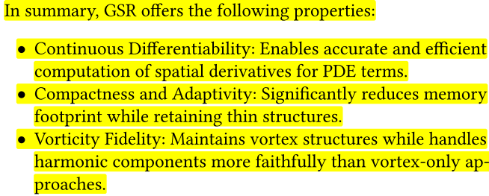
Introduction
They present a new grid-free fluid solver featuring a novel Gaussian Spatial Representation (GSR)

Slide 3
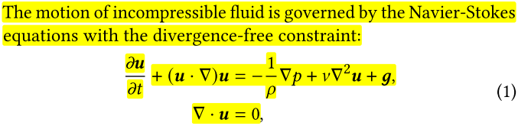
Navier Stokes equation

Slide 4
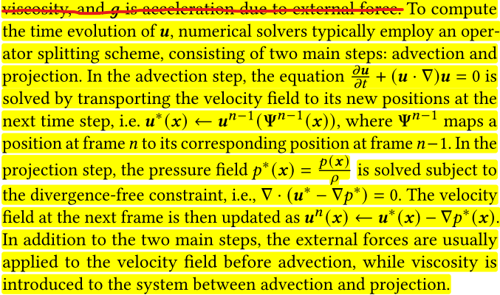
Traditional Solver

Slide 5
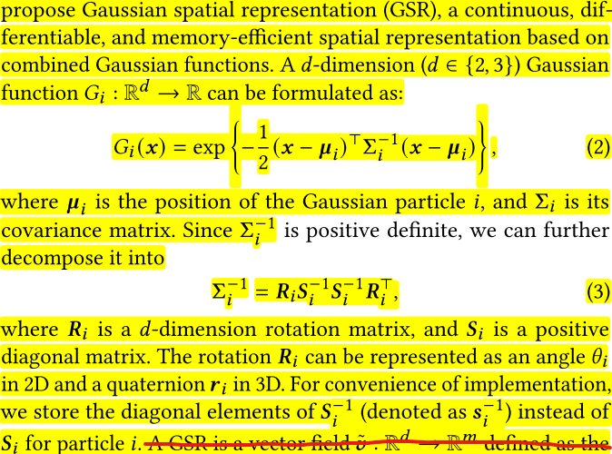
Gaussian Spatial Representation

Slide 6
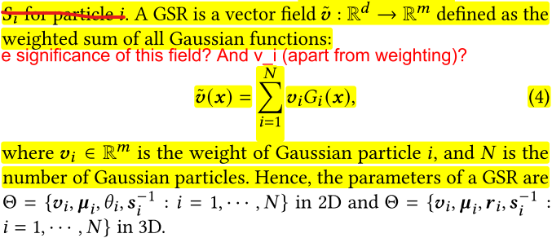
GSR as a vector field

Slide 7
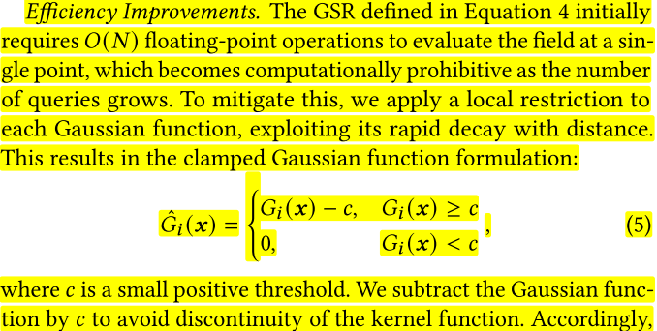
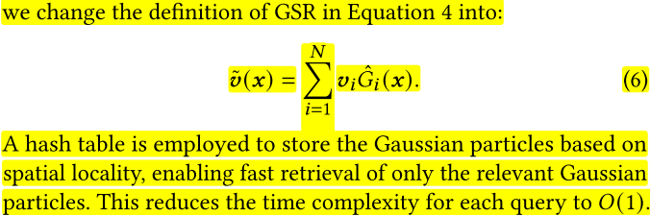
Local restriction to Gaussian

Slide 8
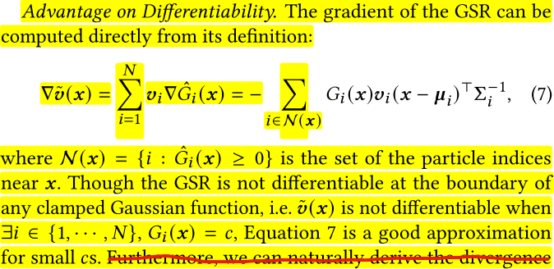
Gaussian differentiability advantage

Slide 9
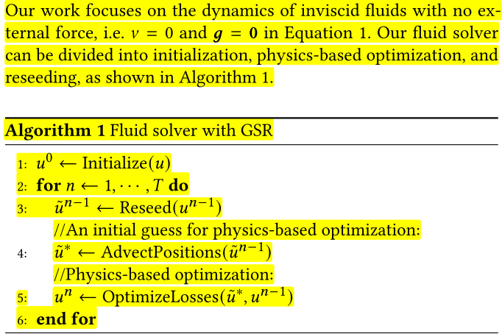
Algorithm

Slide 10
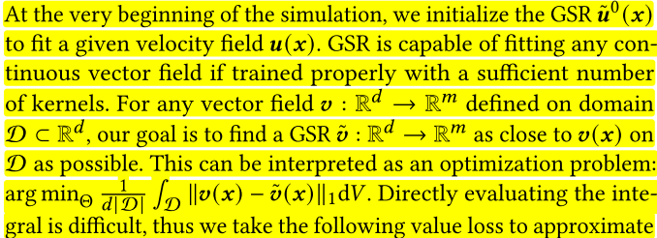
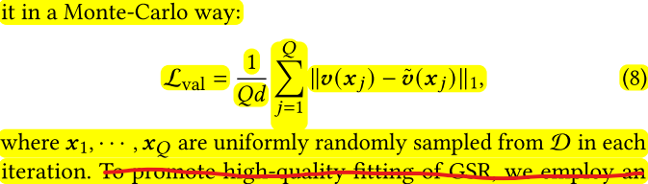
Initialization – Part 1 (Value Loss)

Slide 11
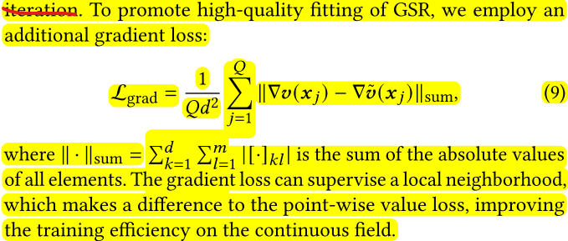
Initialization – Part 2 (Gradient Loss)

Slide 12
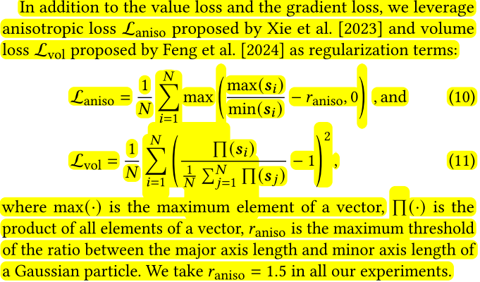
Initialization – Part 3 (Regularization Losses)

Slide 13
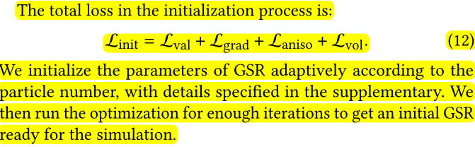
Initialization – Part 4 (Final)

Slide 14
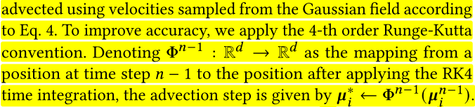
Advection step

Slide 15
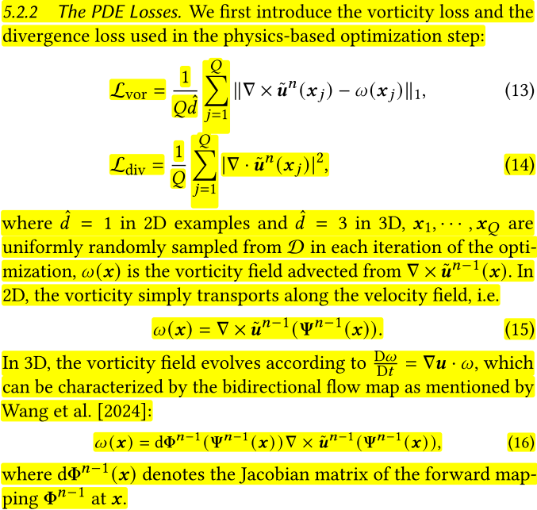
Projection step – Part 1 (Vorticity and Divergence Loss)

Slide 16
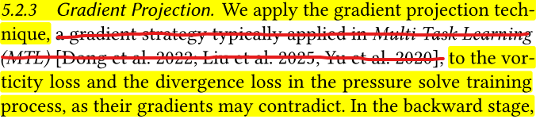
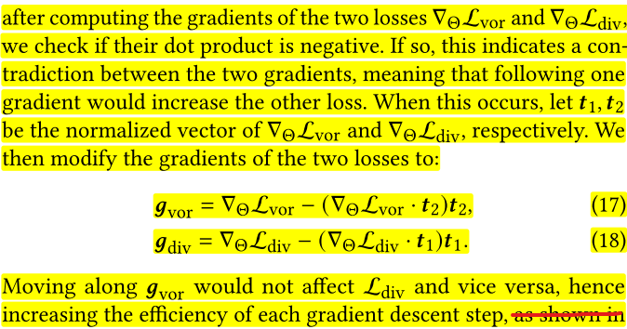
Projection step – Part 2 (Gradient Projection)

Slide 17
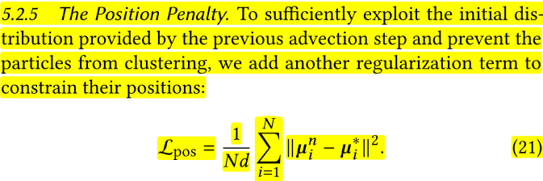
Projection step – Part 3 (Position Penalty)

Slide 18
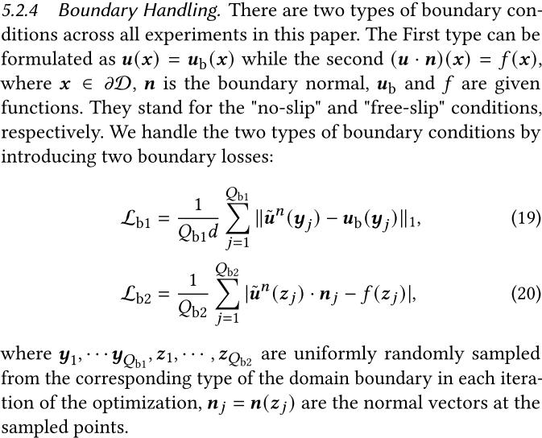
Projection step – Part 4 (Boundary Loss)

Slide 19
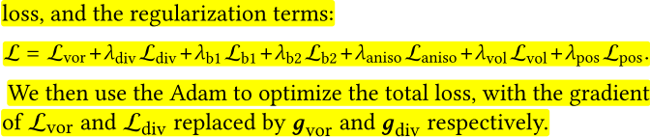
Projection step – Part 5 (Total Loss)

Slide 20
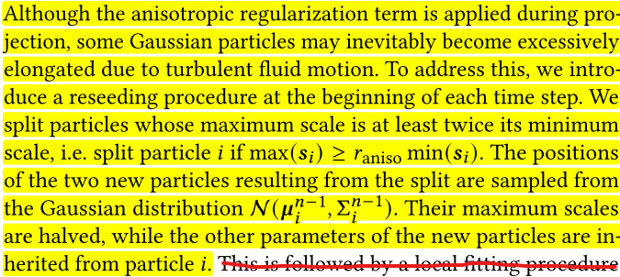
Reseeding

